Slide 1
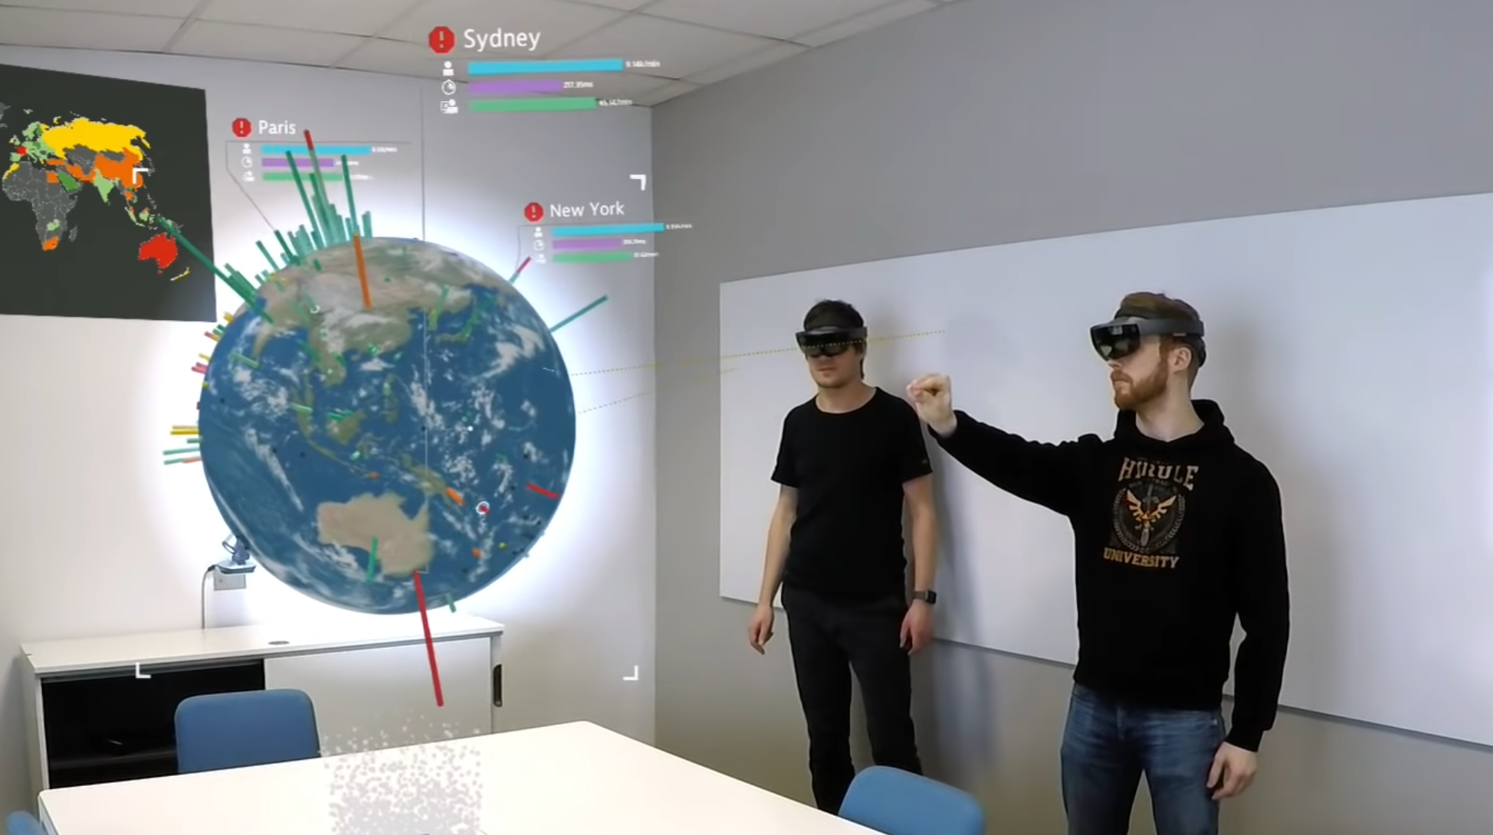
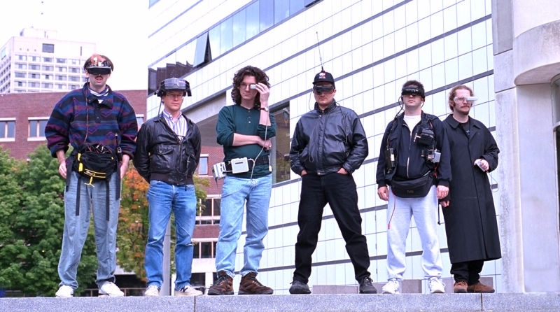
Augmented Reality
“It’s the real world - only better”
Jay Wright, Qualcomm

Slide 2
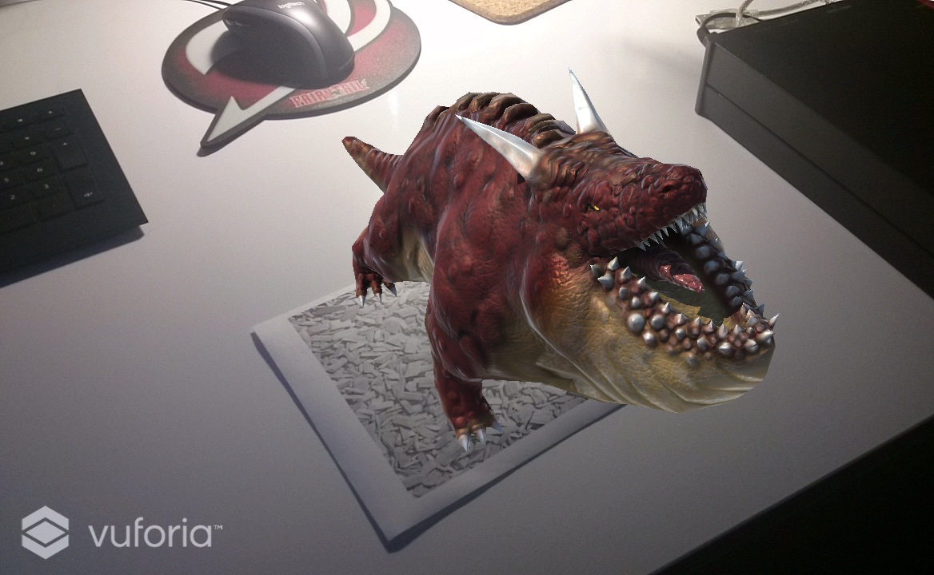
Agenda
Short introduction
What is Augmented Reality?
Types of Augmented Reality
Use-case examples
What are the tools?
Stop talking and show me how it’s done!!!!
2/14

Slide 3
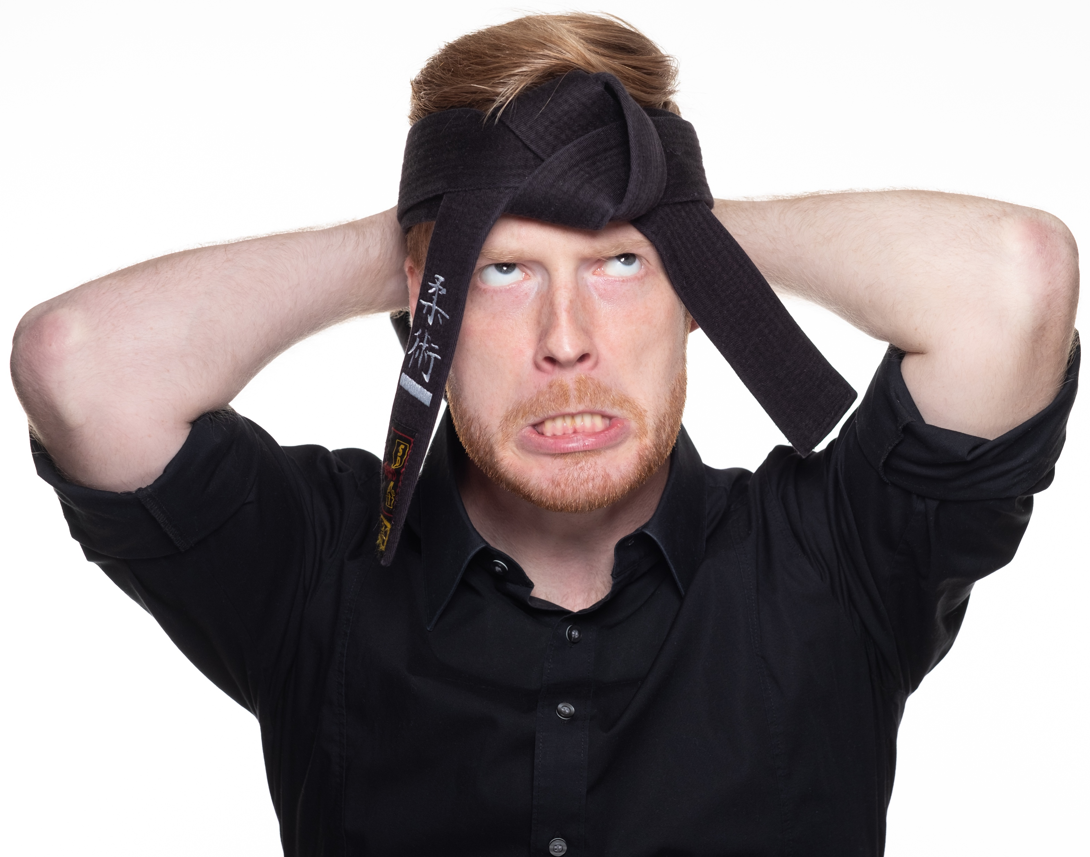




Markus Altenhofer (aka Max)
working at Dynatrace in Linz
.NET dev for a about 10 yrs (focus on Unity for about 4 yrs)
passionate Martial Artist (Jiu Jitsu 1.Dan; Taekwondo 7. Kup)
Pen&Paper RPG lover
Dogster and cat servant
Wanderlust (especially to Japan and South Korea)
3/14

Slide 4
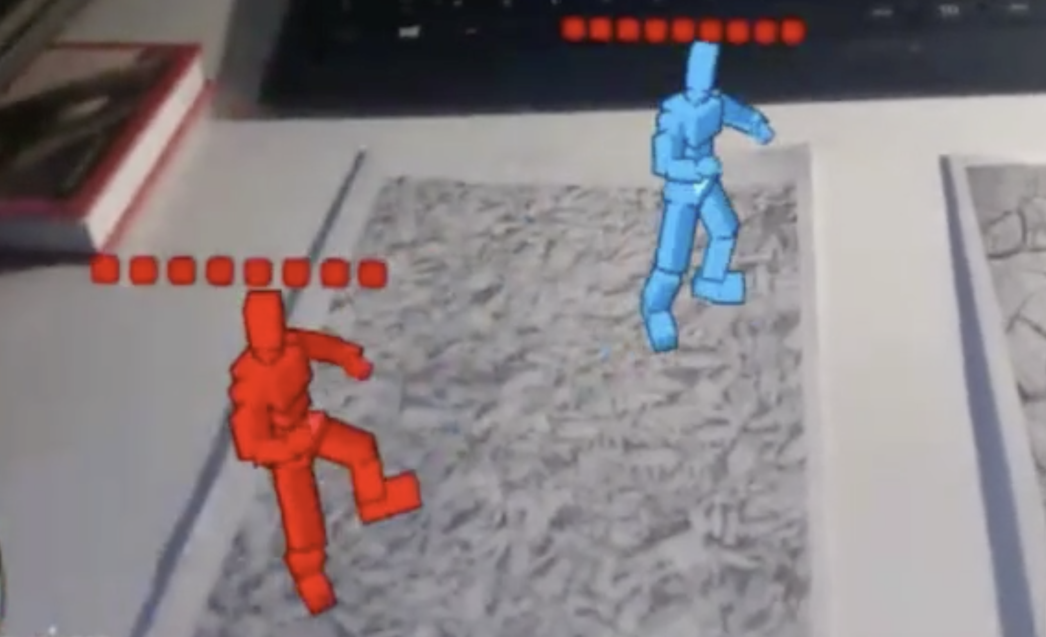
What is Augmented Reality?
Definition of AR (Azuma R., 1997)
AR combines virtual reality with reality
Allows real-time interaction
Three-dimensional reference between real and virtual objects
Augmented reality (AR) is an interactive experience of a real-world environment whereby the objects that reside in the real-world are "augmented" by computer-generated perceptual information ... (Wikipedia)
4/14

Slide 5
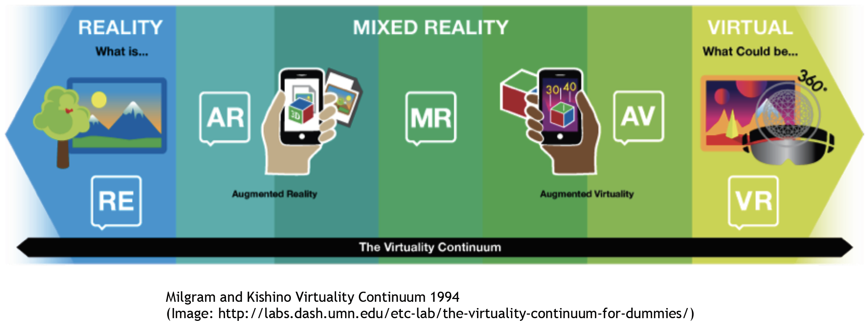
What is Augmented Reality?
Reality -> The real world
Augmented Reality -> Real world with augmented information
Augmented Virtuality -> Virtual world with real world objects
Virtual Reality -> No interaction with the real world
5/14

Slide 6
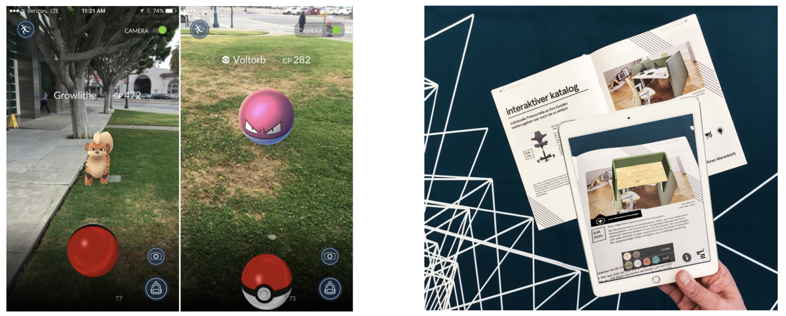
Types of Augmented Reality
Sensor based AR
(Image:http://www.independent.co.uk/artsentertainment/pokemon-go-uk-release-date-and-how-to-get-it-nowon-iphone-and-android-apk-a7127326.html)
Image based AR
Marker Tracking
Natural Feature Tracking
6/14
Notes:
Sensor based:
Gyroscope, Compass & Accelerometer
Tracks the users movement
Not possible to estimate size
Many weak points
Pokemon GO

Slide 7
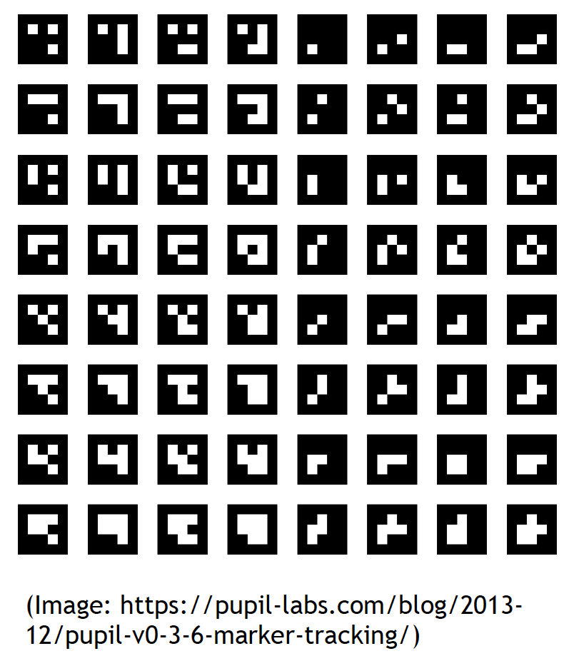

Types of Augmented Reality
(https://gamedev.stackexchange.com/questions/116522/object-not-augmenting-on-small-marker)
Marker Tracking
Natural Feature Tracking
7/14
Notes:
Marker Tracking:
Simple computer vision algorithms
First AR tool
Still often used in industry
Unsuitable for marketing
ARToolKit
Natural Feature Tracking:
More complex than marker tracking
Images of natural things
Perfect for marketing
Good computing power needed
Vuforia & Wikitude

Slide 8
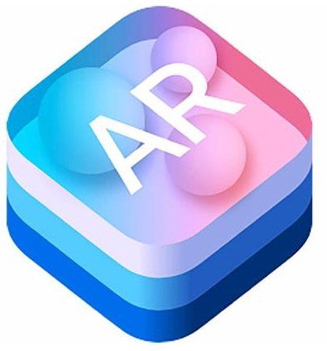




Types of Augmented Reality
Mixed AR
8/14
Notes:
ARKit:
Works with iOS 11 and all devices with an A9, A10 and A11 chip
Visual Inertial Odometry (VIO) tracking
Combines camera sensor data with core motion data
Can be used with Unity, Unreal and Scenekit
Uses the camera sensor to estimate room lightning
Face tracking
ARCore:
AR Framework from Google (Tango technology)
Works only with a limited device set (e.g. Google Pixel (XL) and Samsung Galaxy S8, S9, etc…)
Combines camera sensor data with motion data
Can be used with Unity, Unreal and Android Studio
Inofficial versions for other devices available
Hololens:
Inertial measurement unit (accelerometer, gyroscope, and magnetometer)
Four environment understanding cameras
One HD camera
One depth camera
Four microphones
Ambient light sensor
Three hours battery life
Gesture and voice input
Combines camera sensor data with all other sensors
Used with Unity, Unreal, Windows UWP
Magic Leap:
Separate Processing Unit
Remote control with 6 DOF sensor
IR sensor camera and IR dot projector
Eyetracking IR camera
Two to three hours battery life
4 microphones sensor array

Slide 9
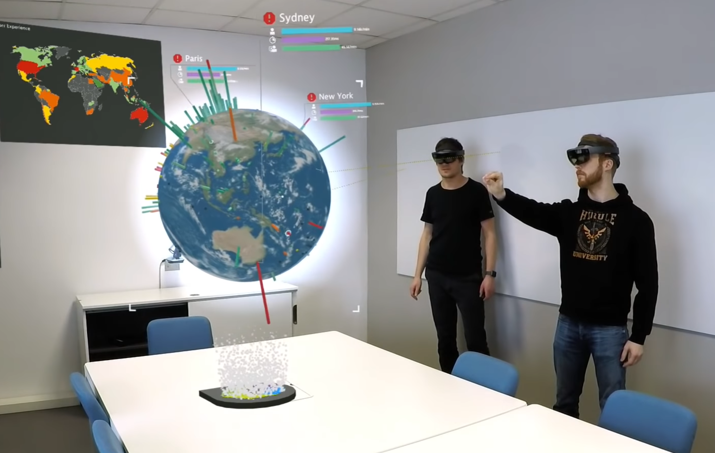


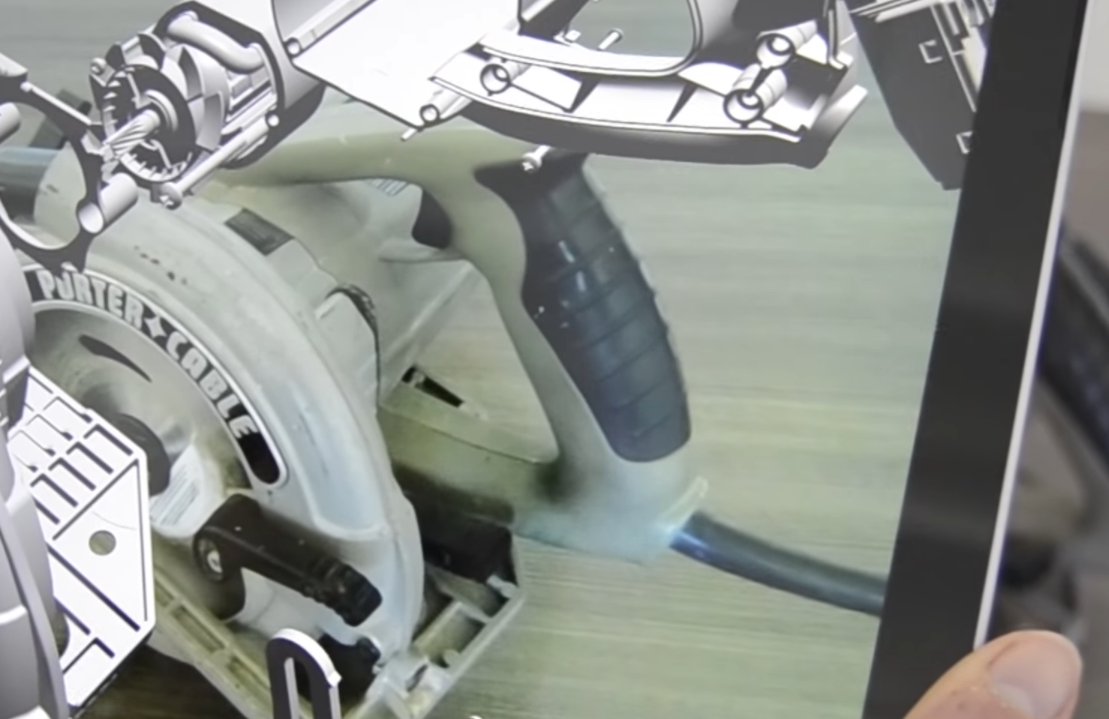
Use-case examples for AR apps
9/14
Notes:
And many more:
Pokemon Go
Snapchat
Apple Face …
AR Measure Kit

Slide 10
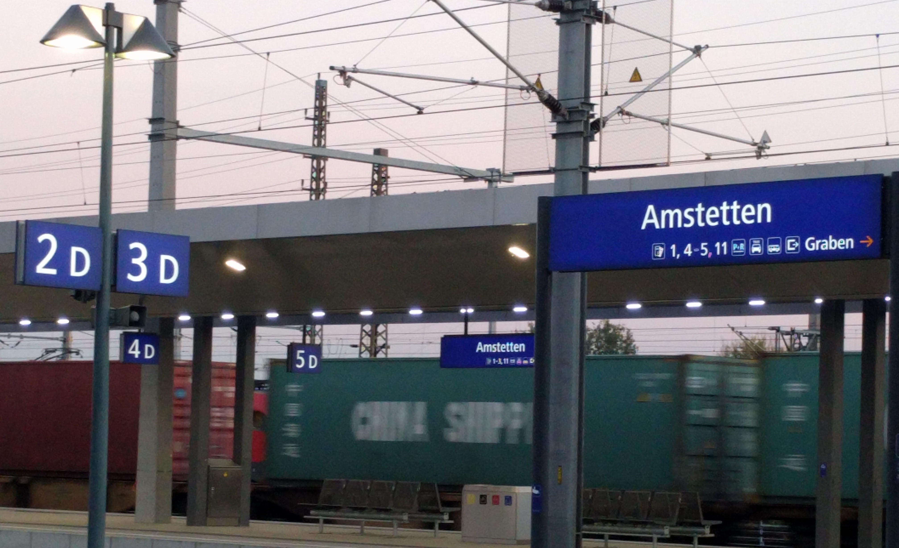
What tools do we need?
10/14

Slide 11
Quick start - What is needed?
Basic knowledge of C# and 3D math
Unity Game Engine with Vuforia Augmented Reality support
opt. external Webcam
Depending on your target application either
Marker
3D Model data
ARKit/ARCore supported devices
11/14

Slide 12

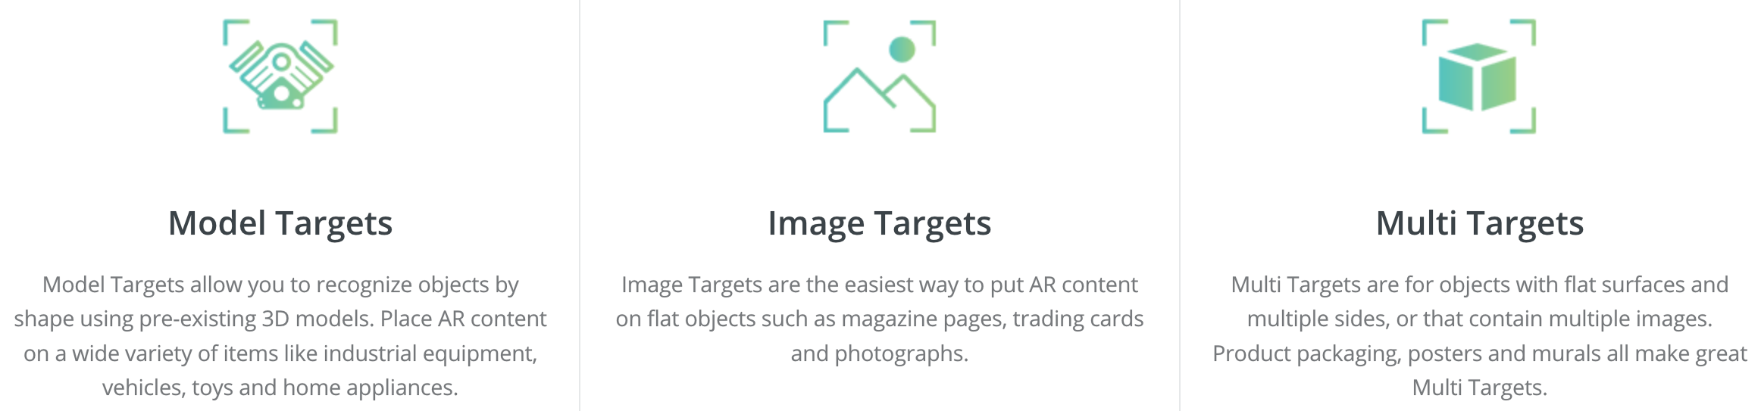
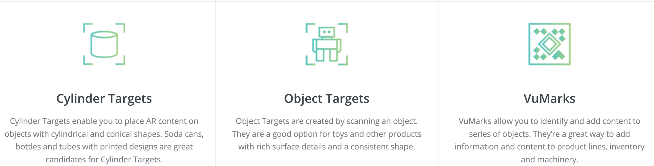
Quick start - What is needed?
12/14

Slide 13
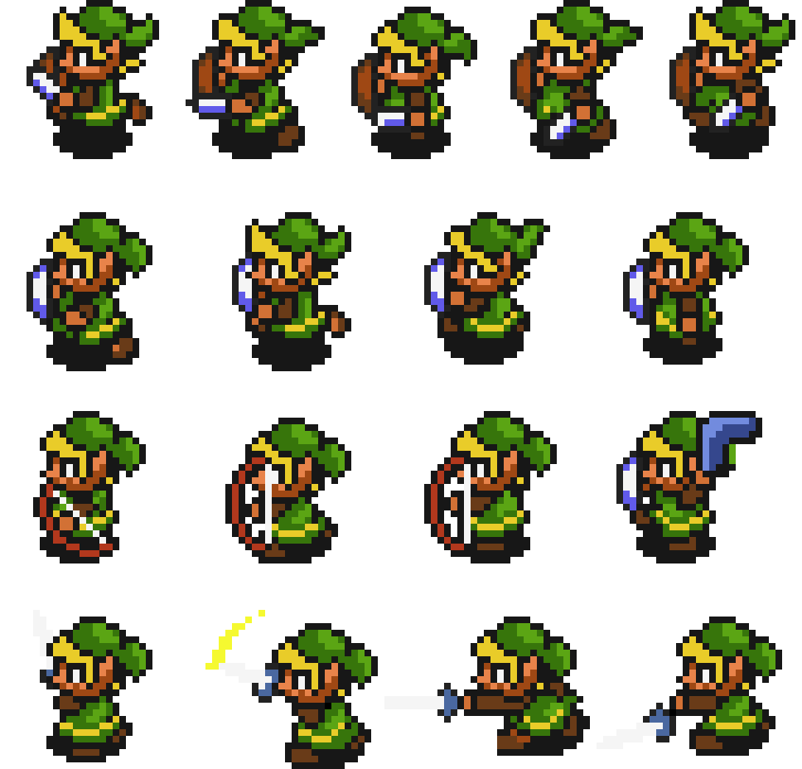
Useful links
https://docs.unity3d.com/Manual/vuforia-sdk-overview.html
https://library.vuforia.com/articles/Training/getting-started-with-vuforia-in-unity.html
https://www.udacity.com/course/learn-arkit-using-unity--ud114?referrer=unity
https://developers.google.com/ar/develop/unity/quickstart-android
https://github.com/Microsoft/MixedRealityToolkit-Unity/tree/mrtk_development
13/14

Slide 14

Quick start - Demo AR app

